Slide 1
CSC 112 : Introduction to Computer Programming
Department of Computer Science
Faculty of Computing and Information
Osun State University, Osogbo, Nigeria.
WEEK 3
2023/2024 session
DR. O.E OJO

Slide 2
Basic programming concepts
Key programming terminologies
Programming languages and IDEs
Describing various language syntax
Compilers/interpreters.

Slide 3
What are Program and programming language?
Program : Set of instructions which a computer can “interpret” to solve problems, make calculations, perform tasks, etc.
Programming Language : A formal language that is intended for the expression of computer programs
Notes:
Syntax is away of writing program in any language (every language has its own syntax)

Slide 4
Why study programming languages?
Programming languages are important for students in all disciplines of engineering because they are the primary tools of the central activity of any science.
To improve your ability to develop effective algorithms and to improve your use of your existing programming language.
To increase your vocabulary of useful programming constructs.
To allow a better choice of programming languages.
To make it easier to learn a new language.

Slide 5
Basic Terminologies in Programming Languages(1/3)
Algorithm: A step-by-step procedure for solving a problem or performing a task.
Variable: A named storage location in memory that holds a value or data.
Data Type: A classification that specifies what type of data a variable can hold, such as integer, string, or boolean.
Function: A self-contained block of code that performs a specific task and can be called from other parts of the program.

Slide 6
Basic Terminologies in Programming Languages(2/3)
Control Flow: The order in which statements are executed in a program, including loops and conditional statements.
Syntax: The set of rules that govern the structure and format of a programming language.
Comment: A piece of text in a program that is ignored by the compiler or interpreter, used to add notes or explanations to the code.
Debugging: The process of finding and fixing errors or bugs in a program.

Slide 7
Basic Terminologies in Programming Languages(3/3)
IDE: Integrated Development Environment, a software application that provides a comprehensive development environment for coding, debugging, and testing.
Operator: A symbol or keyword that represents an action or operation to be performed on one or more values or variables, such as + (addition), – (subtraction), * (multiplication), and / (division).
Statement: A single line or instruction in a program that performs a specific action or operation.

Slide 8
A short history of programming Languages
1950 : Numerically based languages. FORTRAN (55)
Business languages. COBOL(60)
Artificial intelligence languages. LISP, ALGOL(58)
1970 : PLs Ada, C, Pascal, Smalltalk
1980 : Object-oriented programming: Smalltalk, C++
90s:
Fourth-generation languages
Visual languages : Delphi
Scripting languages : Perl
Object-oriented programming: Java
Advanced scripting language & bject-oriented programming language - Python

Slide 9
Low-level vs. High-level Programming Languages
Low-level:
Machine code
Assembly
High-level: (abstraction from the computer details)
Basic, C, Java, Pascal, C++, Perl, Python, …
Notes:
Assembly is translated by assembler to machine code.

Slide 10
Styles of Computer Programming
Procedural: procedures, routines, subroutines, methods, or functions
e.g. C, Pascal, Basic, Fortran
Functional
Mathematical functions
e.g. Lisp, Erlang, Haskell, ML, …
Object-oriented
e.g. C++, Java, Smalltalk
Rule-based (or Logic) : facts, rules
e.g. Prolog

Slide 11
Attributes of a good language
Ease of program verification
Proof of correctness, desk checking, test
Simplicity of semantic and syntax
Programming environment
Portability of programs
Cost of use
Program execution
Program translation
Program creation, testing, and use
Program maintenance

Slide 12
Compilers & Programs
Compiler
A program that converts another program from some source language (or high-level programming language / HLL) to machine language (object code).
Some compilers output assembly language which is then converted to machine language by a separate assembler.
Is distinguished from an assembler by the fact that each input statement, in general, correspond to more than one machine instruction.

Slide 13
Compilation into Assembly L
Assembly Language
Source
Program
Compiler
Assembly Language
Machine Language
Assembler
Notes:
Instead of to ML
Facilitates debugging
Isolates compiler from changes in format of ML (new OS)
Only assembler must be changed!

Slide 14
Compilers & Programs
Source program
The form in which a computer program, written in some formal programming language, is written by the programmer.
Can be compiled automatically into object code or machine code or executed by an interpreter.
Pascal source programs have extension ‘.pas’

Slide 15
Compilers & Programs
Object program
Output from the compiler
Equivalent machine language translation of the source program
Files usually have extension ‘.obj’
Executable program
Output from linker/loader
Machine language program linked with necessary libraries & other files
Files usually have extension ‘.exe’

Slide 16
What is a Linker?
A program that pulls other programs together so that they can run.
Most programs are very large and consist of several modules.
Even small programs use existing code provided by the programming environment called libraries.
The linker pulls everything together, makes sure that references to other parts of the program (code) are resolved.

Slide 17
Running Programs
Steps that the computer goes through to run a program:
Memory
Machine language program (executable file)
C P U
Input Data
Data entered during execution
Computed results
Program Output

Slide 18
Program Execution
Steps taken by the CPU to run a program (instructions are in machine language):
Fetch an instruction
Decode (interpret) the instruction
Retrieve data, if needed
Execute (perform) actual processing
Store the results, if needed

Slide 19
Program Errors
Syntax Errors:
Errors in grammar of the language
Runtime error:
When there are no syntax errors, but the program can’t complete execution
Divide by zero
Invalid input data
Logical errors:
The program completes execution, but delivers incorrect results
Incorrect usage of parentheses

Slide 20
Compilation
Source
Program
Compiler
Target
Program
Input
Target Program
Output
Compiler translates source into target (a machine language program)
Compiler goes away at execution time
Compiler is itself a machine language program, presumably created by compiling some other high-level program
Machine language, when written in a format understood by the OS is object code

Slide 21
Interpretation
Source
Program
Interpreter
Output
Input
The interpreter stays around during execution
It reads and executes statements one at a time

Slide 22
Compilation vs. Interpretation
Compilation:
Syntax errors caught before running the program
Better performance
Decisions made once, at compile time
Interpretation:
Better diagnostics (error messages)
More flexibility
Supports late binding (delaying decisions about program implementation until runtime)
Can better cope with PLs where type and size of variables depend on input
Supports creation/modification of program code on the fly (e.g. Lisp, Prolog)

Slide 23
Mixture of C & I
Source
Program
Translator
Intermediate
Program
Intermediate
Program
VM
Output
Input
Many programming languages implement this
Interpreter implements a Virtual Machine (VM).

Slide 24
JAVA
For portability:
Java
Compiler
bytecode
ML
Interpreter
For flexibility: Just In Time (JIT) compiler translates bytecode into ML just before execution

Slide 25
SUMMARY OF IMPLEMENTATION METHODS
Compilation – Programs are translated into machine Language & System calls.
Interpretation – Programs are interpreted by another program (an interpreter).
Hybrid – Programs translated into an intermediate language for easy interpretation.
Just –in-time – Hybrid implementation, then compile sub programs code the first time they are called.

Slide 26
APPLICATION DOMAINS
SCIENTIFIC APPLICATIONS: can be characterized as those which predominantly manipulate numbers and arrays of numbers, using mathematical and statistical principles as a basis for the algorithms. (FORTRAN, Pascal, Math lab are programming languages that can be used here).
DATA PROCESSING APPLICATIONS: can be characterized as those programming problems whose predominant interest is in the creation, maintenance, extraction and summarization of data in records and files. COBOL is a programming language that can be used for data processing applications.

Slide 27
APPLICATION DOMAINS
TEXT PROCESSING APPLICATIONS: are characterized as those whose principal activity involves the manipulation of natural language text, rather than numbers as their data. SNOBOL and C language have strong text processing capabilities.
ARTIFICIAL INTELLIGENCE APPLICATIONS: are characterized as those programs which are designed principally to emulate intelligent behavior. They include game playing algorithms such as chess, natural language understanding programs, computer vision, robotics and expert systems. LISP has been the predominant AI programming language, and also PROLOG using the principle of ‘’Logic programming’’. Lately AI applications are written in Java, C++ and python.

Slide 28
APPLICATION DOMAINS
SYSTEMS PROGRAMMING APPLICATIONS: involve developing those programs that interface the computer system ( the hardware) with the programmer and the operator. These programs include compilers, assembles, interpreters, input-output routines, program management facilities and schedules for utilizing and serving the various resources that comprise the system. Ada, Modula – 2 and C are examples of programming languages used here.
WEB SOFTWARE: Web software is a collection of languages which include:
Markup (e.g. XHTML)
Scripting for dynamic content under which we have the
Client side, using scripts embedded in the XHTML documents e.g. JavaScript, PHP
Server side, using the common Gateway interface e.g. JSP, ASP, PHP
General- purpose, executed on the web server through cGI e.g. Java, C++.

Slide 29
Integrated Development Environment (IDE)
An IDE is software that combines commonly used developer tools into a compact GUI (graphical user interface) application. It is a combination of tools like a code editor, code compiler, and code debugger with an integrated terminal.
Common Features of an IDE:
Editor
Compiler
Debugger
Build-in Terminal
Version Control
Code snippets
Extensions and Plugins
Code navigation

Slide 30
Integrated Development Environment (IDE)
Reason for using IDE:
Productivity
Code Quality
Integrated Environment
Customizability
Types of IDEs
1. Desktop IDEs: This type includes the IDEs that can be configured locally. They do not need an active internet connection to build/run programs. Examples: include Microsoft Visual Studio, Eclipse, Netbeans VSCode, PyCharm
2. Cloud IDEs: Cloud IDEs eliminate the overhead of configuring the software locally. They run on remote servers and can be accessed through desktop browsers. Examples: Include Gitpod, AWS Cloud 9, Replit, etc.

Slide 31
Integrated Development Environment (IDE)
Types of IDEs
3. Mobile App Development IDEs: These IDEs are specially designed for creating mobile applications. They include features like Emulator support and integration for developing and testing mobile applications. Examples: Include Android Studio, Flutlab.io, etc.
4. Database-Specific IDEs: These IDEs (Integrated Development Environments) are specially designed for working with databases. They include features like query builders and n for developing and testing mobile applications. Examples: Include MySQL Workbench, Oracle SQL Developer, etc.

Slide 32
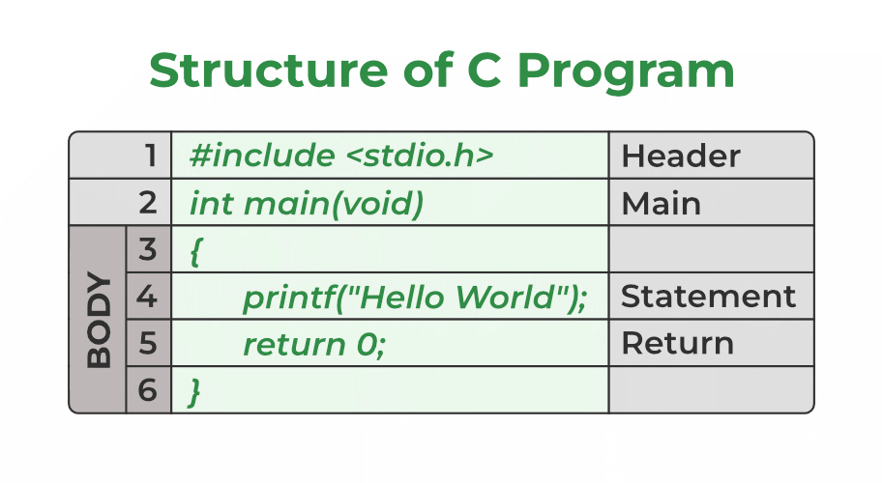
Various Programming language syntax

Slide 33
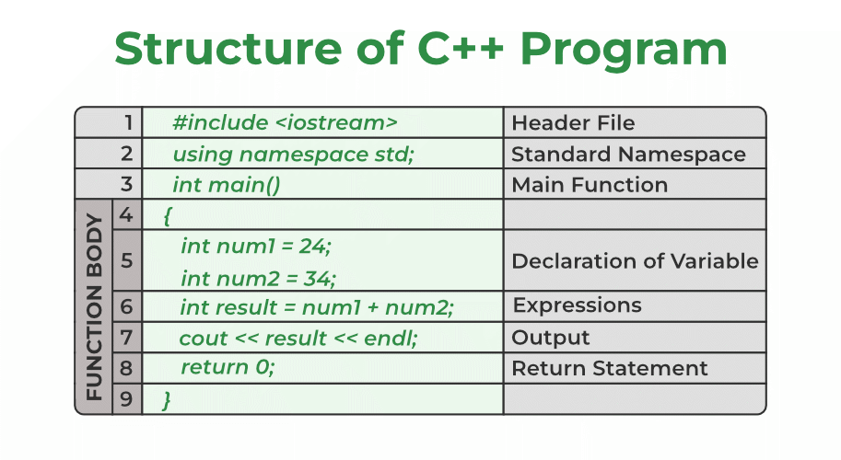
Various Programming language syntax

Slide 34
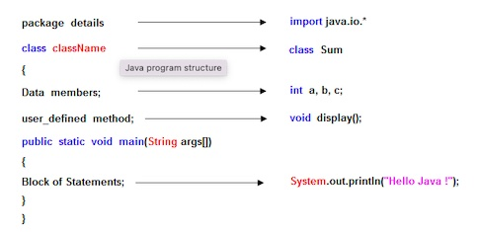
Various Programming language syntax
JAVA

Slide 35
Various Programming language syntax
PYTHON
print(&quot;Hello, World!&quot;)
Output:
Hello, World

Slide 36
Various Programming language syntax
PYTHON
import sys
# Check if at least one number is provided
if len(sys.argv) < 2:
print("Please provide numbers as arguments to sum.")
sys.exit(1) # Exit with an error status code
try:
# Convert arguments to floats and sum them
total = sum(map(float, sys.argv[1:]))
print(f"Sum: {total}")
except ValueError:
print("All arguments must be valid numbers.")

